Slide 1

Smart Wearable Controlling System by Hand and Finger Gestures
Tran, Viet Cuong
Department of Electronics Engineering, Keimyung University
Daegu, Korea
25th October 2017

Slide 2
Content
Introduction
System Design
Method
Experiments and Results
Conclusion & Future Work

Slide 3
Content
Introduction
Gesture Recognition
Literature View
Smart Wearable Controlling System
System Design
Evaluation Result
Conclusion & future work

Slide 4
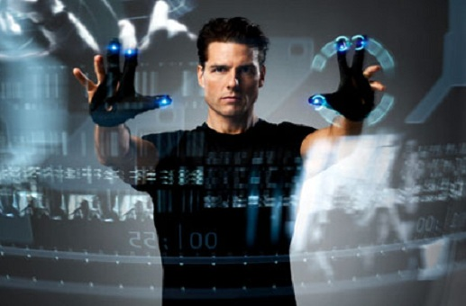
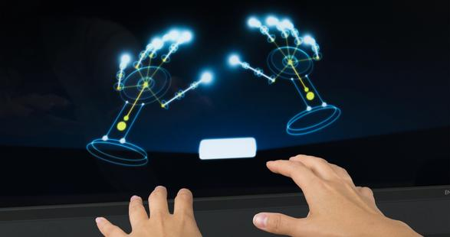
Gesture Recognition
Gesture recognition has become on of the popular research fields that served as an intelligent and a natural interface.
Exploring alternative ways to recognize the imitate human gestures to perform complex and difficult tasks in various areas.
Wearable computing trends allowed devices to be portable and smaller in size.

Slide 5
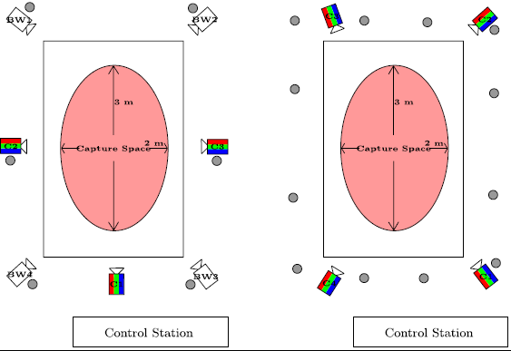
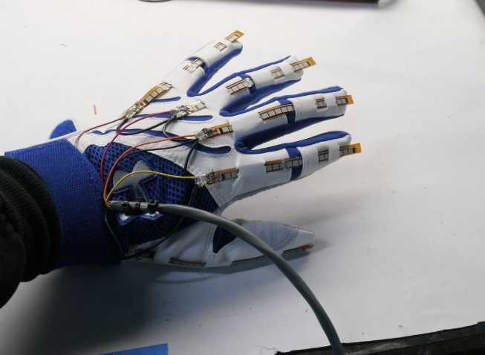
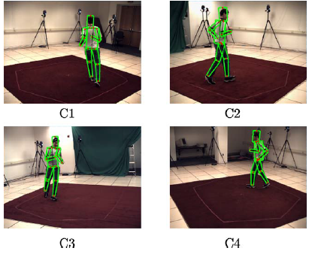
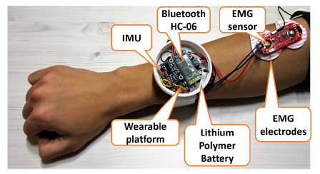
Literature Review
Pathk [2] presented a framework for hand gesture recognition
Vicon system [1] captures the motions by using multiple high-speed infrared cameras
Gesture control armband using single EMG and IMU

Slide 6
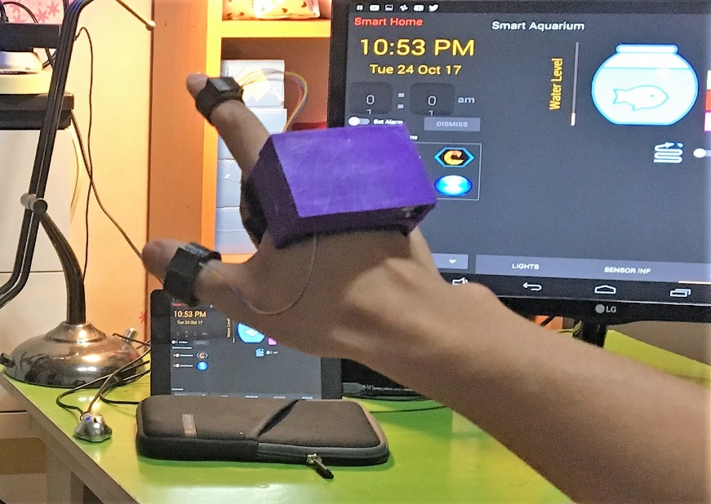
Smart Wearable Controlling System
Tend to wearable computing trend and high accuracy rate:
Utilizing only three IMUs
Recognizing 22 gestures

Slide 7
Content
Introduction
System Design
System Overview
Design of Hardware
Design of Software
Method
Experiments and Results
Conclusion & future work

Slide 8
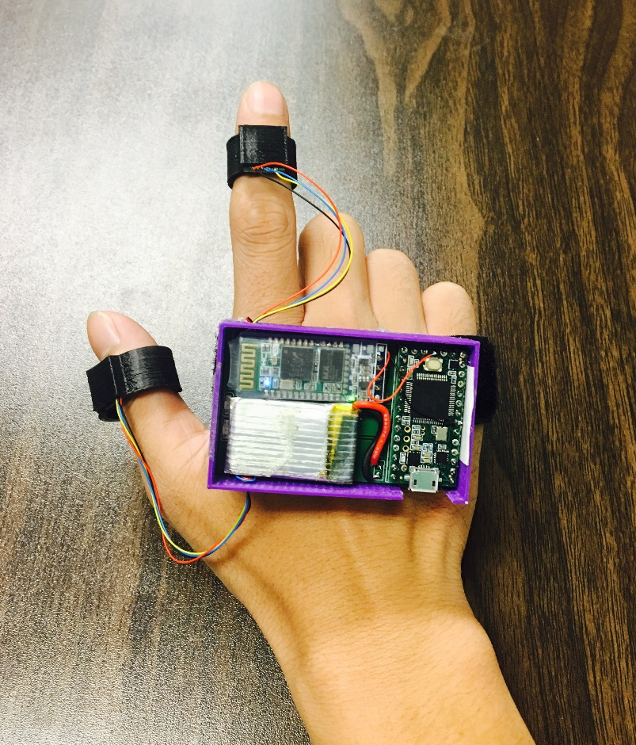
System Overview
IMU sensors
IMU Multiplexer
The system includes:
Sensor module
Processing module
Mobile device
Bluetooth module
Processing Module

Slide 9
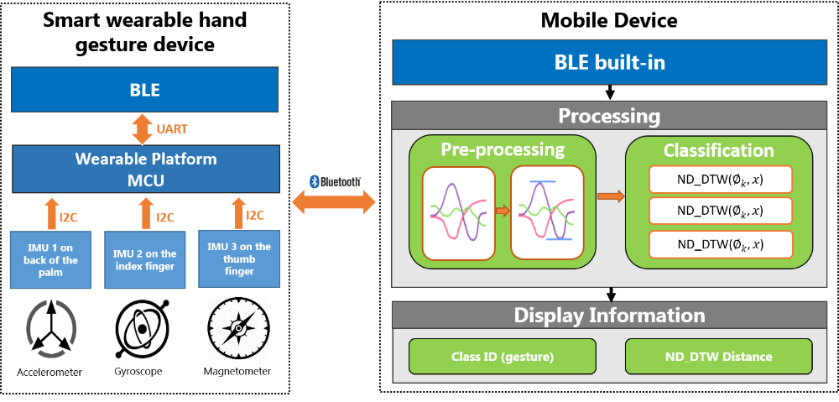
System Overview
System design overview.

Slide 10
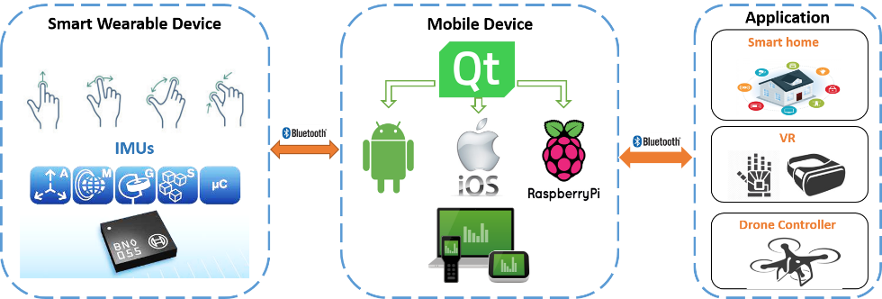
System Overview
Qt cross platform software
Applying to various applications as home automation, games controller …
Proposed smart wearable controller system can be applied to various applications.

Slide 11
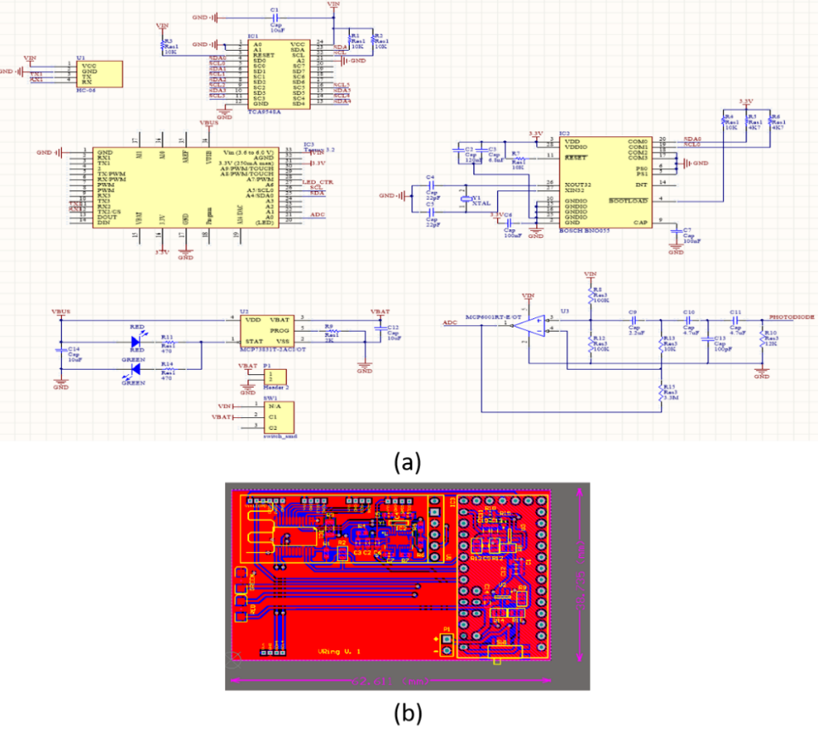
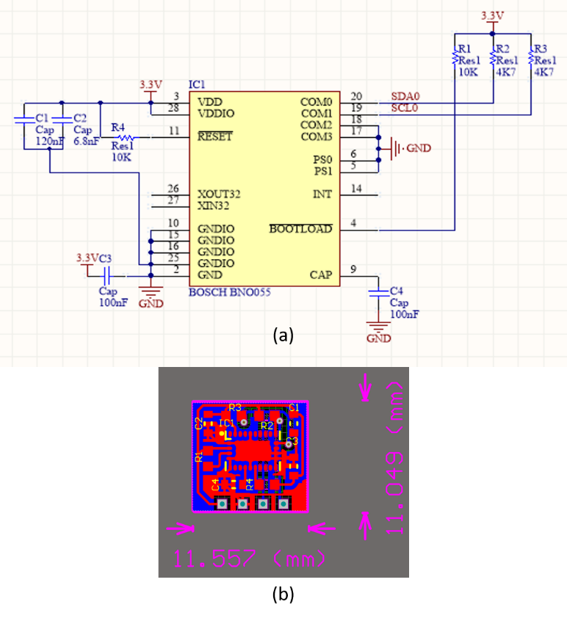
Hardware
(a) Schematic and (b) PCB layer design of processing module.
(a) Schematic and (b) PCB layer design of sensor module.

Slide 12
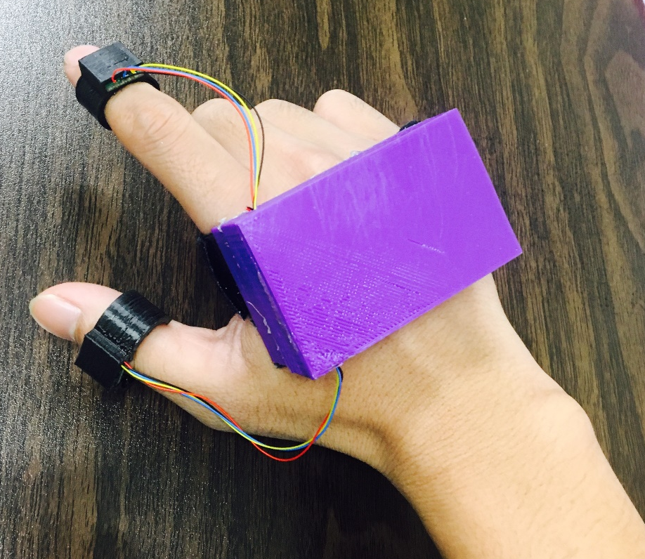
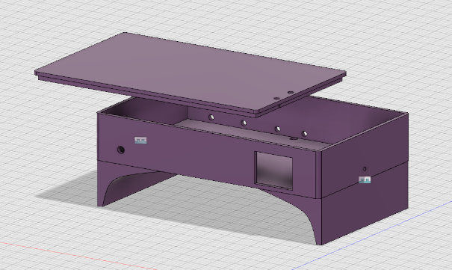
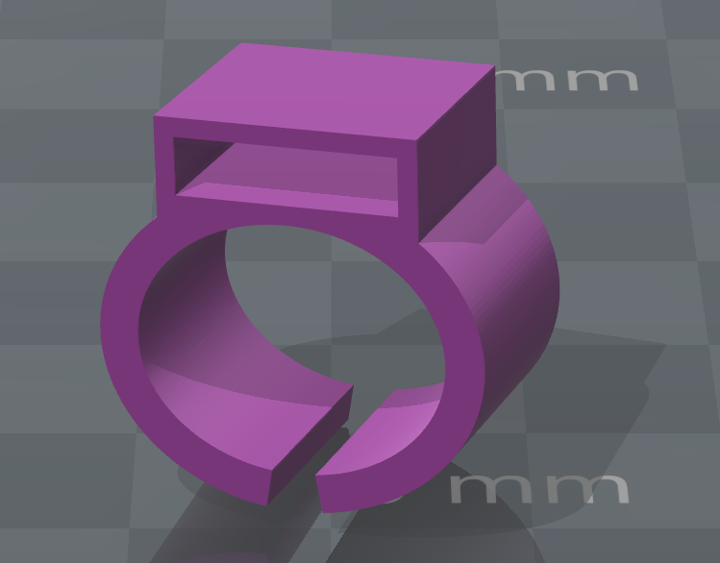
Hardware
Appearance design using 3D Printer

Slide 13
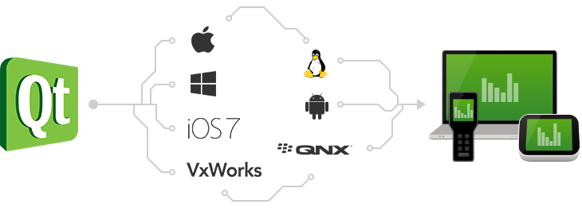
Design of Software
Cross-platform application framework (Linux, OS X, Windows, Android, iOS).
Framework written in C++.
GUI is written in QML instead of the whole application whereas the application’s backend is written in C++.
Qt cross-platform application development framework.

Slide 14
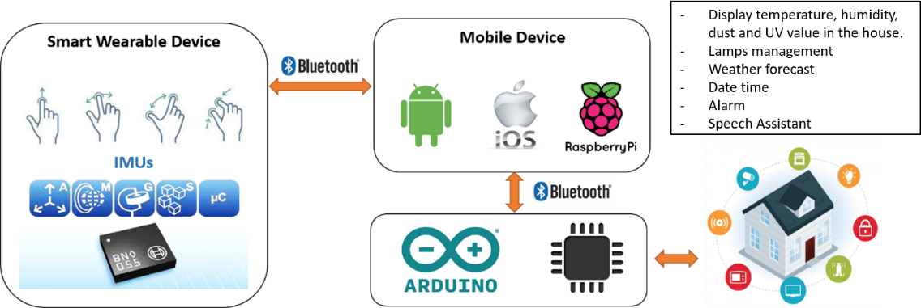
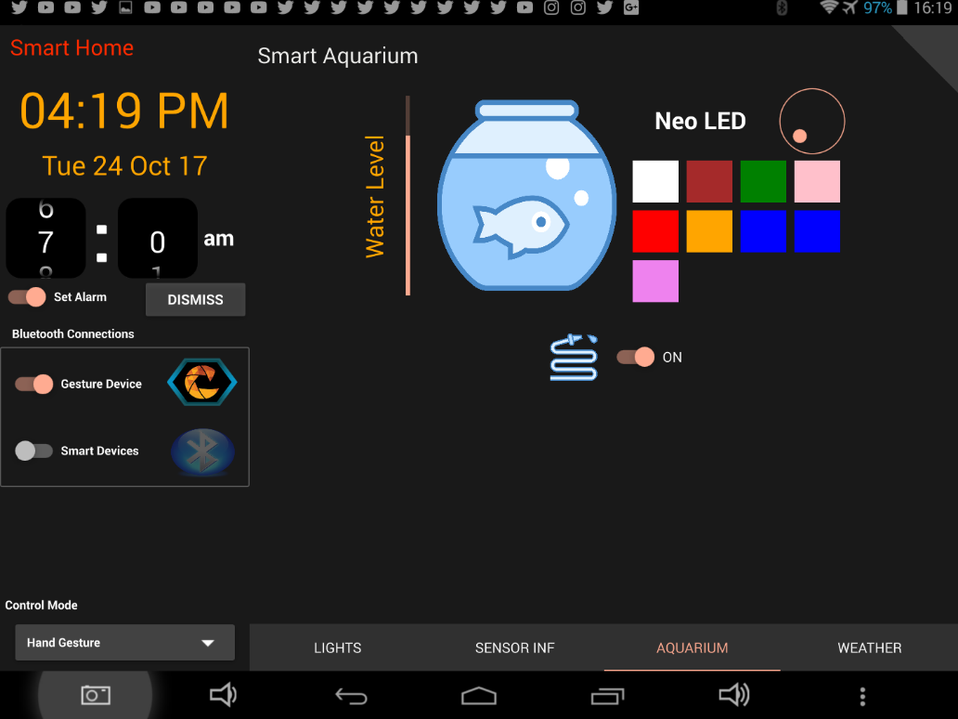
Design of Software
System overview of smart home application.
Screenshot of the smart home application

Slide 15
Design of Software
Video Demo

Slide 16
Content
Introduction
System Design
Method
Dynamic Time Warping (DTW)
N Dimension – DTW
Pre-processing
Training
Classification Threshold
Experiments and Results
Conclusion & future work

Slide 17
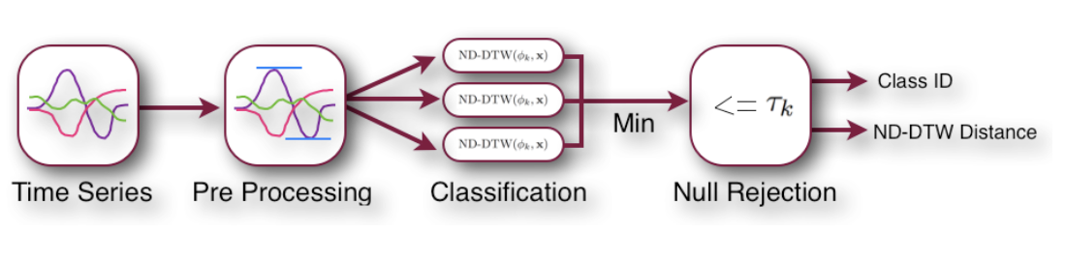
Method
Flowchart of method

Slide 18
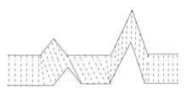
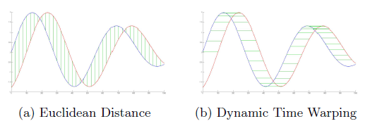
Dynamic Time Warping (DTW)
DTW is an algorithm that can compute the similarity between two time-series, even if the lengths of the time-series do not match.
DTW has been applied to temporal sequences of video, audio, graphics data and gesture recognition.
Two identical time-series signals, with phase differences measured with (a) Euclidean distance and (b) Dynamic Time Warping.

Slide 19
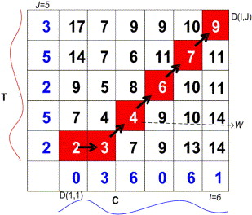
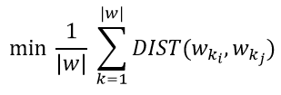
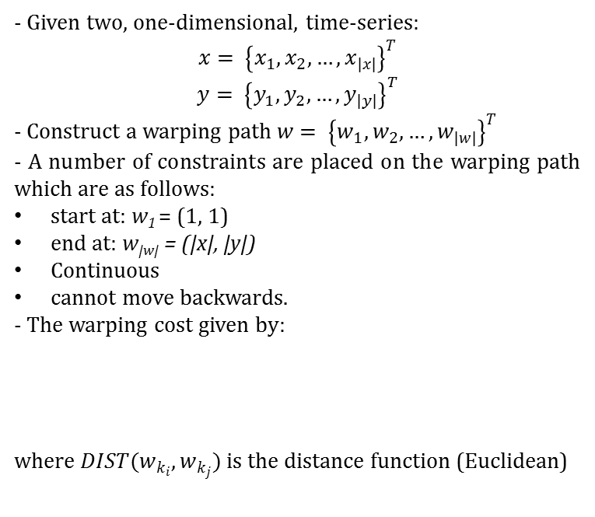
Dynamic Time Warping (DTW)
- Given two, one-dimensional, time-series$:$
$$x= {\left\{x_{1}, x_{2}, …, x_{|x|}\right\}}^{T}$$
$$y= {\left\{y_{1}, y_{2}, …, y_{|y|}\right\}}^{T}$$
- Construct a warping path $w= {\left\{w_{1}, w_{2}, …, w_{|w|}\right\}}^{T}$
- A number of constraints are placed on the warping path which are as follows:
start at: w₁ = (1, 1)
end at: w_{|w|} = (|x|, |y|)
Continuous
cannot move backwards.
- The warping cost given by:
where $DIST(w_{k_{i}}, w_{k_{j}})$ is the distance function (Euclidean)
Example of warping path in a distance table. Length of class sequence, x = 6 and length of test sequence, y = 5.

Slide 20
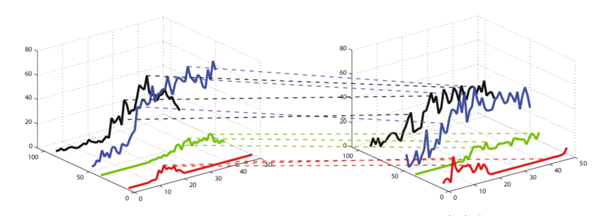
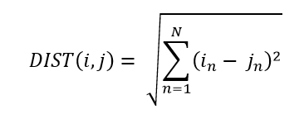
N Dimension DTW
Computing the distance between 2 given time-series.
The total distance across all N dimensions is used to construct the warping matrix with the Euclidean distance:
Multiple dimension DTW

Slide 21
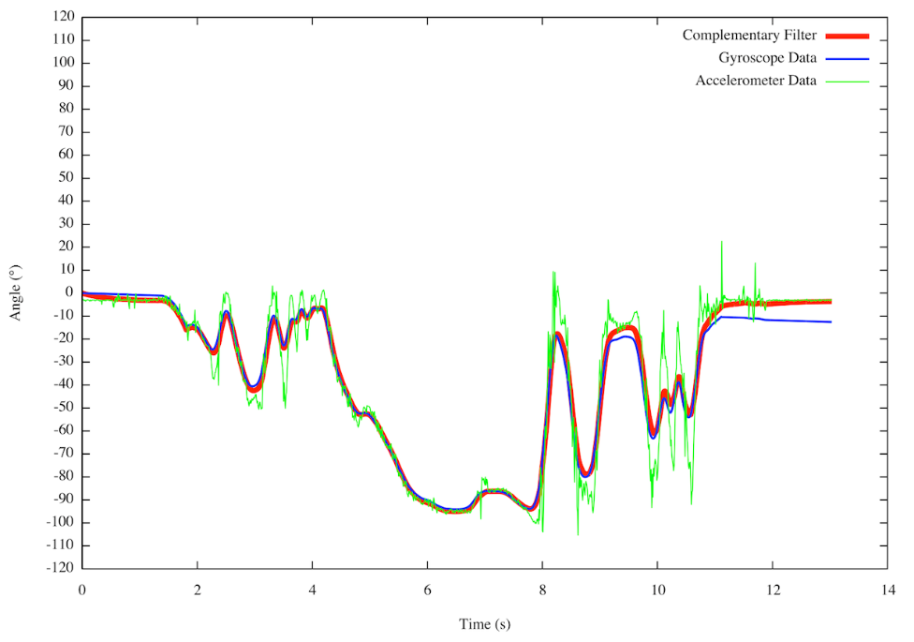
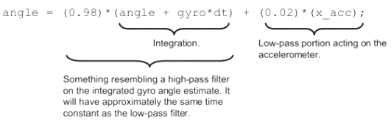
Pre-processing
Accelerometer is reliable only in the long run, but so noise in the short run.
Gyroscope is reliable only in the short run, but is drifted in the long run
Using measurement by the fusion of accelerometer and gyroscope data with Complementary filter:

Slide 22
Training
Template is required to store all the intended gestures in database by recording M_{g} training samples for each of the G gestures
Each of G template can be found by computing distance each of M_{g} training samples
Searching for the training samples that provide the minimum warping distances when compare the other training samples in that class

Slide 23
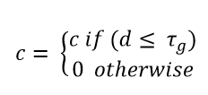
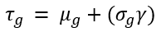
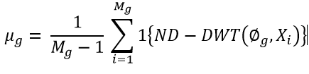
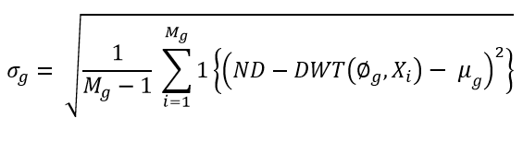
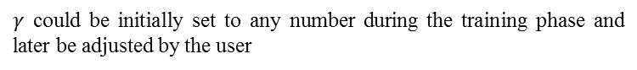
Classification Threshold
The N-dimensional input time-series X is not matched with any of the gestures in the template
Thus this false classification issue can be resolved by defining a classification threshold for each gesture in the template during the training phase.
The algorithm will indicate the particular gesture as no match:
where d is the total normalized warping distance
$γ$ could be initially set to any number during the training phase and later be adjusted by the user

Slide 24
Content
Introduction
System Design
Method
Experiments and Results
Experiment Setup
Results and Discussions
Conclusion & future work

Slide 25
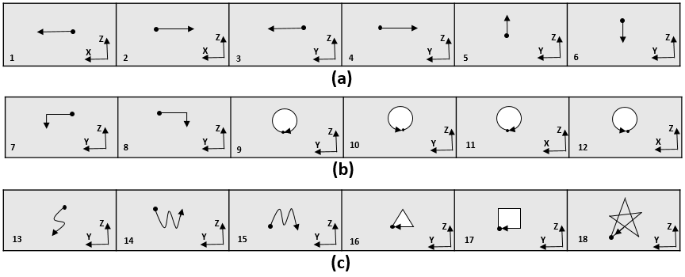
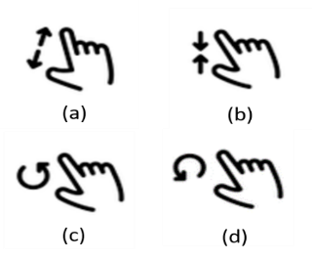
Experiment Setup
Six right handed subjects are voluntarily participated in the experiments.
Subjects are requested to perform 25 repetitions of 22 gestures.
The gestures consisted of 18 hand gesture and 4 fingers gestures.
Four finger gestures
The predefined 18 gestures

Slide 26
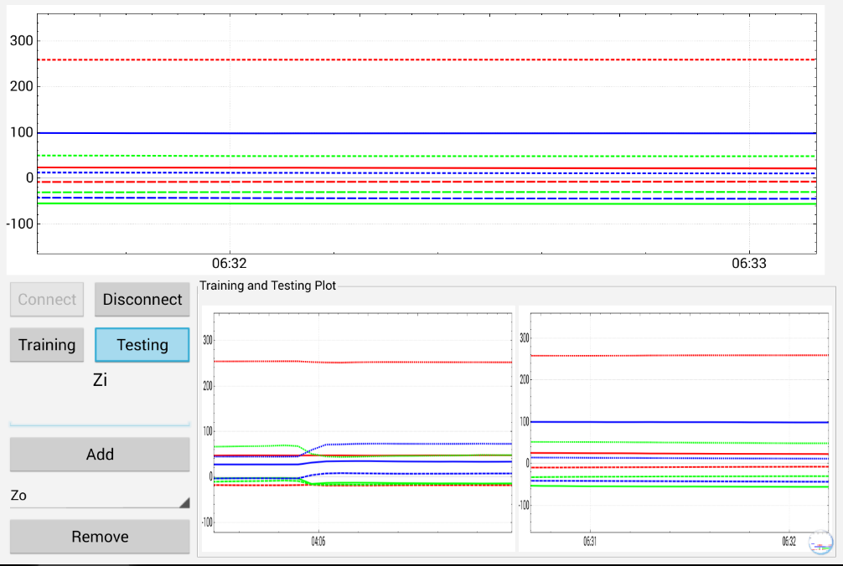
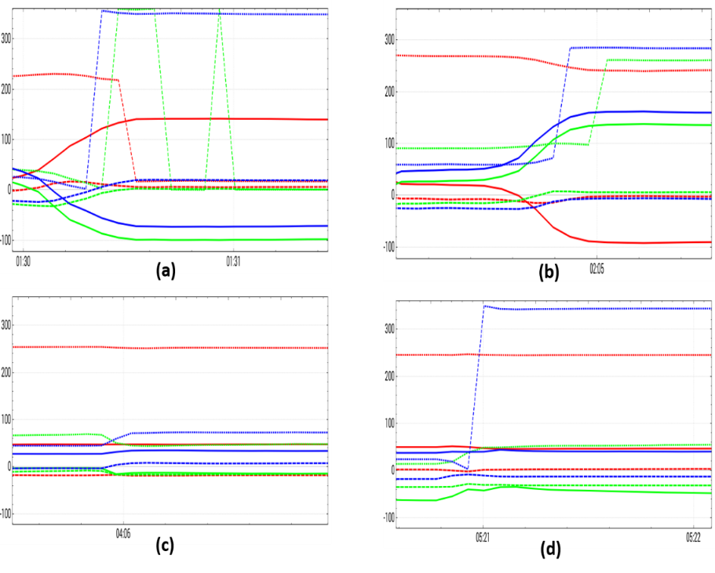
Experiment Setup
Self-development application for the purposes of training phase and testing phase.
Orientation samples obtained from 3 IMUs to the gestures including (a) rotate right, (b) rotate left, (c) zoom in and (d) zoom out.

Slide 27
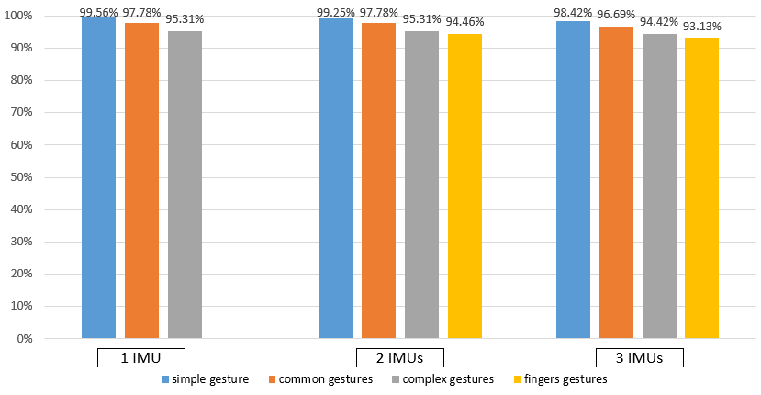
Result and Discussion
Experiments are conducted to validate the gesture recognition accuracy rate utilizing the ND-DTW algorithm.
The impact to accuracy rate based on the quantity of IMUs used are also taken into consideration.
The ND-DTW model was trained using 6-fold cross validation method

Slide 28
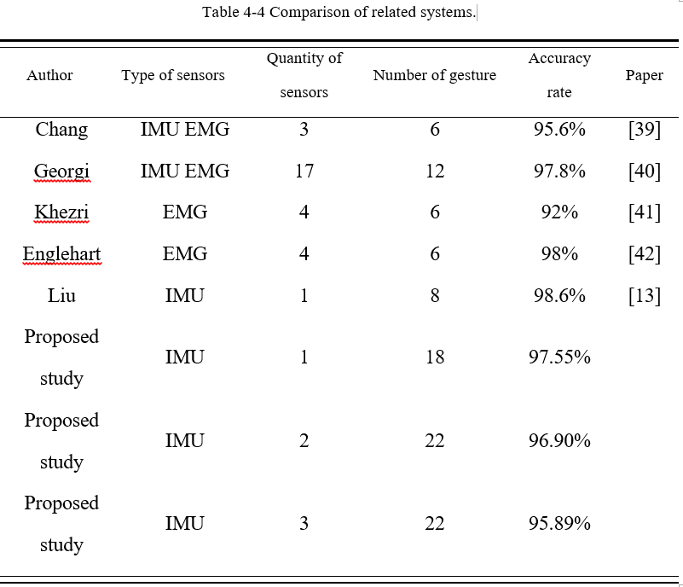
Result and Discussion

Slide 29
Content
Introduction
System Design
Method
Experiments and Results
Conclusion & future work
Conclusion
Future Work

Slide 30
Conclusion
Focused on the design and implementation of smart wearable controller system using hand and fingers for gesture recognition.
The system utilized 3 IMUs sensors, to recognize total of 22 pre-defined gestures with DTW algorithm with low cost implementation and high accuracy rate.
The study evaluated the IMUs quality impacted to the accuracy rate of system.
System performed well with low energy consumption of 10 hours with 3.7V 240mA battery

Slide 31
Future Work
Optimization of PCB design in term of size and dimensionality to reduce power consumption and its wearable comfortability.
Implementation of recognition algorithm in embedded hardware as standalone system which is compatible to different software platforms.
Recognition of more complex gestures that involved three dimensional gestures by utilizing hand and fingers motion.
Inclusion of more functionalities for various applications and allow gestures self-customization by users.

Slide 32
THANK YOU!
UBIQUITOUS SENSOR NETWORK LABORATORY

Slide 33
Q&A
UBIQUITOUS SENSOR NETWORK LABORATORY

Slide 34
Reference

